Slide 1
Security Basics

Slide 2
Overview
Content
Security threats
Basics of Computers and Networking
Security Objectives
After this module, you should be able to
Describe various security threats and objectives
Understand confidentiality, integrity, availability properties
Security Challenges

Slide 3
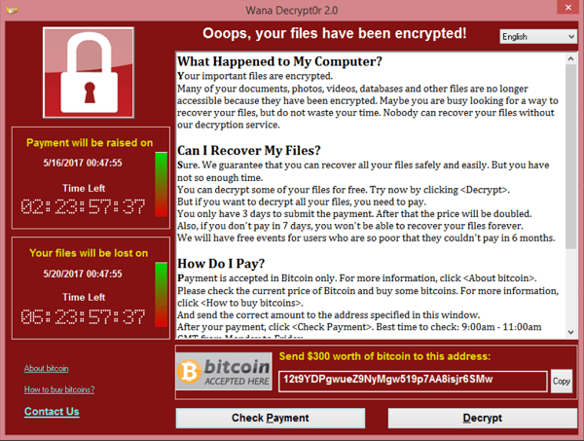
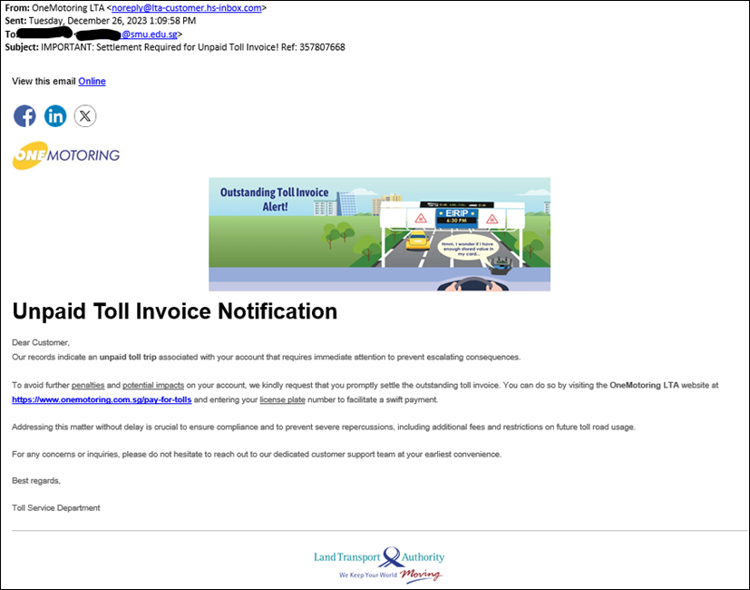
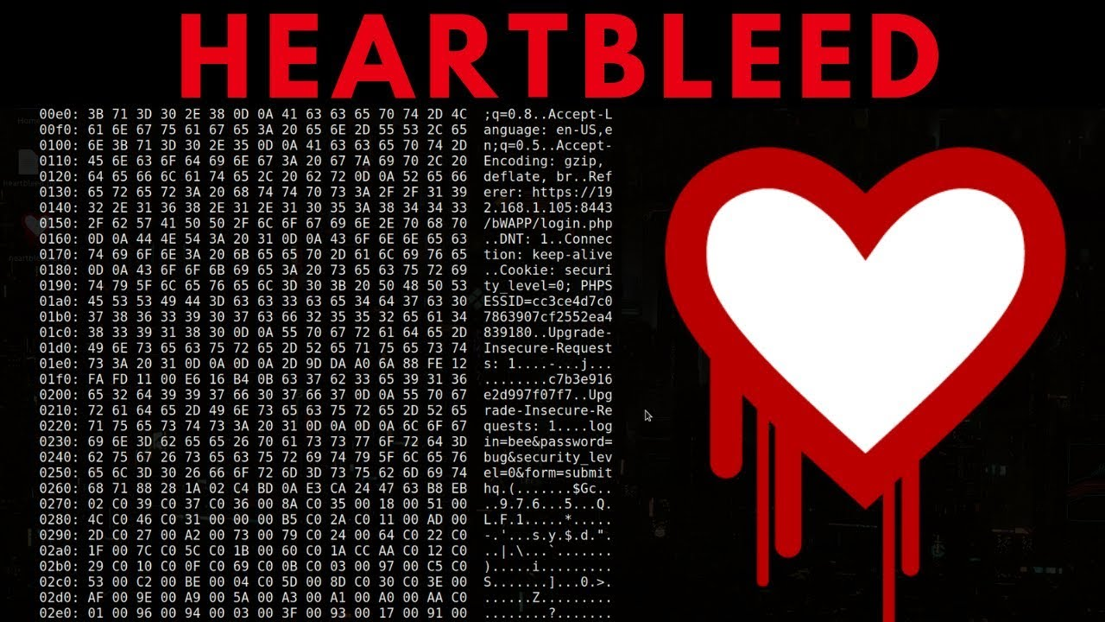
Cyber attacks are everywhere!

Slide 4
Why Are We Threatened?
Cybersecurity 101 https://www.youtube.com/watch?v=sdpxddDzXfE
Fundamental Reasons
  Resource Sharing
    e.g., programs running under the same OS, computers in the same network, virtual machines in the same cloud, …
  Dependence
    e.g., a communication depending on intermediary devices, OS execution depending on application inputs (occasionally), a program execution depending on inputs from the network …

Slide 5



Display
Display
app
app
app
app
app
app
?
OS
?
OS
?
Computer System A
Computer System B

Slide 6
Three types of threats
Threats on the “road”
eavesdropping, tampering, phishing, rogue routing, …
Threats at “home”
spyware, ransom-ware, trojan horse, worm
Threats at “guest house”
leakage from the server

Slide 7
A Glance into Computers
Instruction execution
Memory
CPU privilege
Out of Scope

Slide 8
Execution of flow of instructions
CPU
CPU continuously fetches instructions from the main memory.
The address of the instruction to fetch is stored in a register (e.g. EIP) which is updated automatically.
All addresses used by CPU are virtual addresses.
MMU maps virtual addresses to physical address.
Using different address spaces:
  more efficient physical memory utilization
  more flexible control of the software
MMU
instruction
fetch
read/write
code
data
main memory
CPU: Central Processing Unit
MMU: Memory Management Unit
Out of Scope

Slide 9
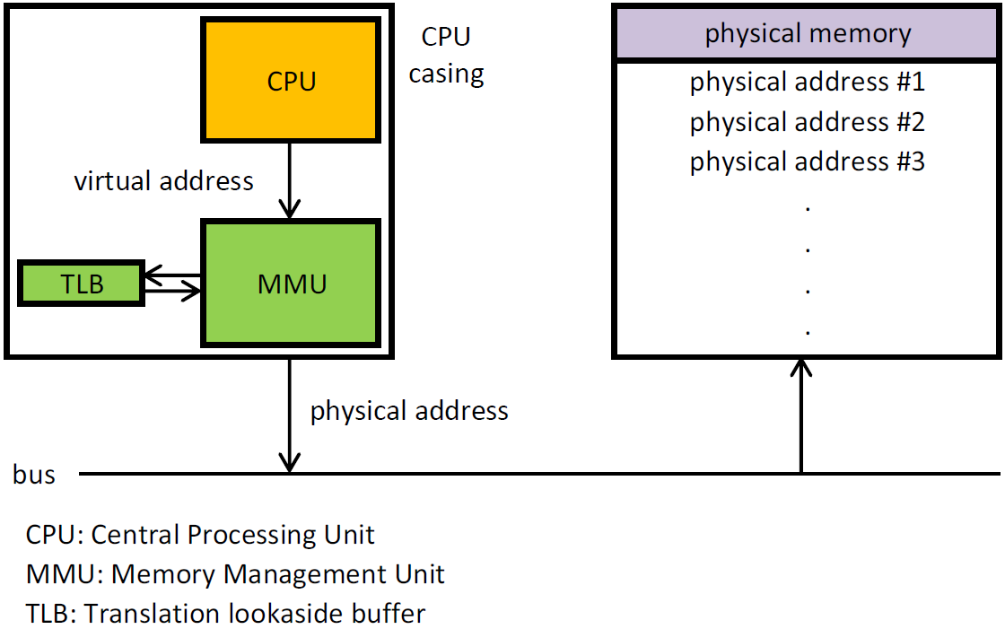





Memory access
By Mdjango, Andrew S. Tanenbaum - Own work, CC BY-SA 3.0, https://commons.wikimedia.org/w/index.php?curid=20478405
Out of Scope

Slide 10
Importance of Main Memory
The main memory is the storage for code and data.
It is “physically shared” by ALLLLL programs in the computer, though “virtually separated”
Many malware compromises require memory corruption or illicit memory accesses.
  memory corruption: modified code or data
  illicit memory access: information leakage.
Out of Scope

Slide 11
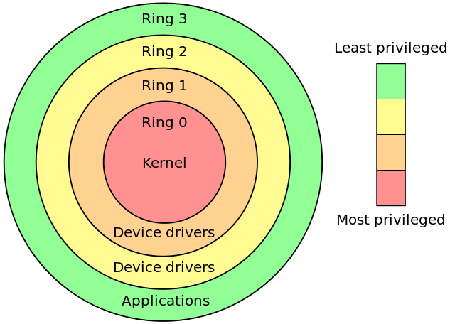

CPU Privilege (Protection) Ring
Privilege = Order / Hierarchy
CPU always runs in a particular Ring which decides:
  whether the current code accesses the memory and I/O ports;
  whether an instruction can be executed. (Some instructions can only be run when CPU in Ring 0, e.g., loading control registers, CR3)
  Some memory regions (e.g., I/O registers, kernel code) can only be accessed when CPU is in Ring 0.
CPU Privilege is important to protect sensitive resources
By Hertzsprung at English Wikipedia, CC BY-SA 3.0, https://commons.wikimedia.org/w/index.php?curid=8950144
CPU Privilege is NOT related to user/root privilege
Out of Scope
Notes:
Protection ring provide different levels of access to resources.
Special call gates between rings are provided to allow an outer ring
to access an inner ring's resources in a predefined manner, as opposed to allowing arbitrary usage.
Correctly gating access between rings can improve security by preventing programs from one ring
or privilege level from misusing resources intended for programs in another.
For example, spyware running as a user program in Ring 3 should be prevented from
turning on a web camera without informing the user, since hardware access should be a Ring 1 function reserved for device drivers.
Programs such as web browsers running in higher numbered rings must request access to the network, a resource restricted to a lower numbered ring.
CR3 – contain physical address of page directory table
every process has its own page table

Slide 12
A Glance into Networking
Physical networks
TCP/IP Internet Protocol suite
Routing
Important services
Out of Scope

Slide 13
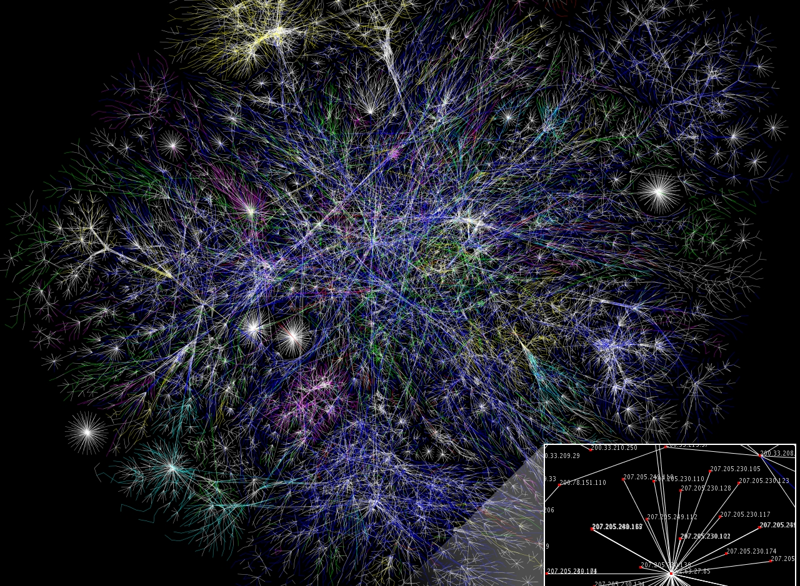
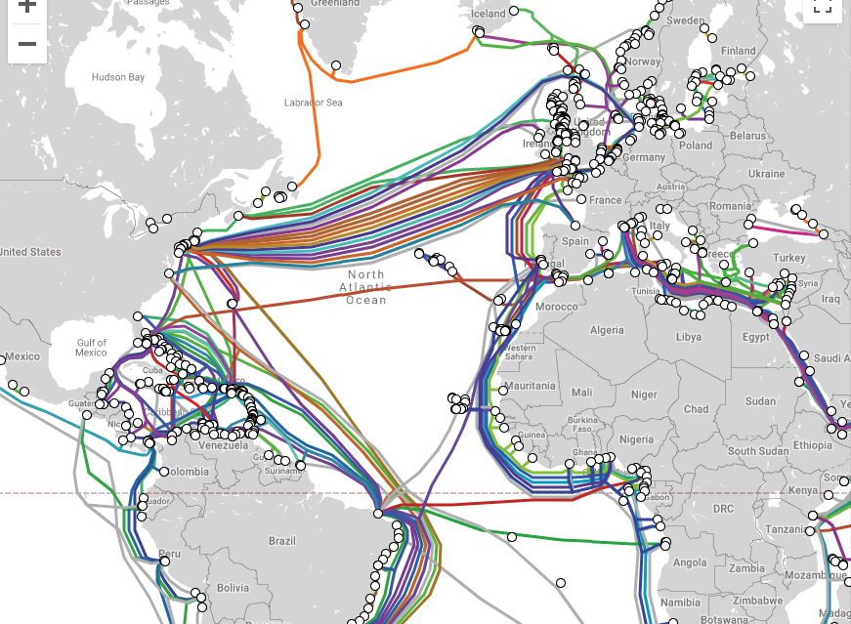
We are connected, physically!
Connections among ISPs
https://commons.wikimedia.org/w/index.php?curid=1538544
Undersea cables
https://www.submarinecablemap.com/#/
Out of Scope

Slide 14

TCP/IP Internet Protocol Suite
Business Application
Business Application
Application
Transport
Network
Data Link
Physical
Application
Transport
Network
Data Link
Physical
Host A
Host B
Internet
IP datagram/packet (network packet)
Src IP Adr; Des IP Adr Src Port#; Des Port# Payload
Network (IP) header
Transport (TCP/UDP) header
Out of Scope

Slide 15
TCP/IP Internet Protocol Suite
Layer Name | Description
Application | Consists of standard communication services and applications that everyone can use
Transport | Manages the transfer of data and assures that received and transmitted data are identical
Network | Manages data addressing and delivery between networks
Data Link | Handles the transfer of data across the network media; provides error handling
Physical | Defines the characteristics of the network hardware
https://docs.oracle.com/cd/E19455-01/806-0916/6ja85398m/index.html
Out of Scope
Notes:
Not yet done.

Slide 16
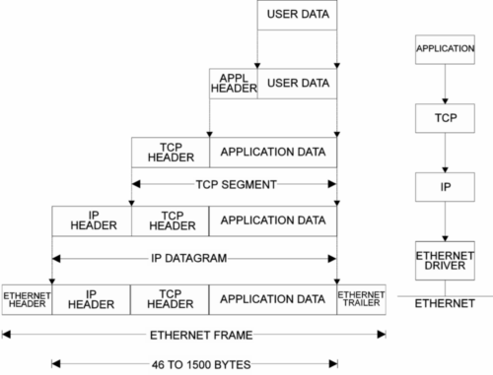





IP (Network) Packet
Out of Scope
image source: https://www.ccontrols.com/ieu/courses/ie201.html

Slide 17
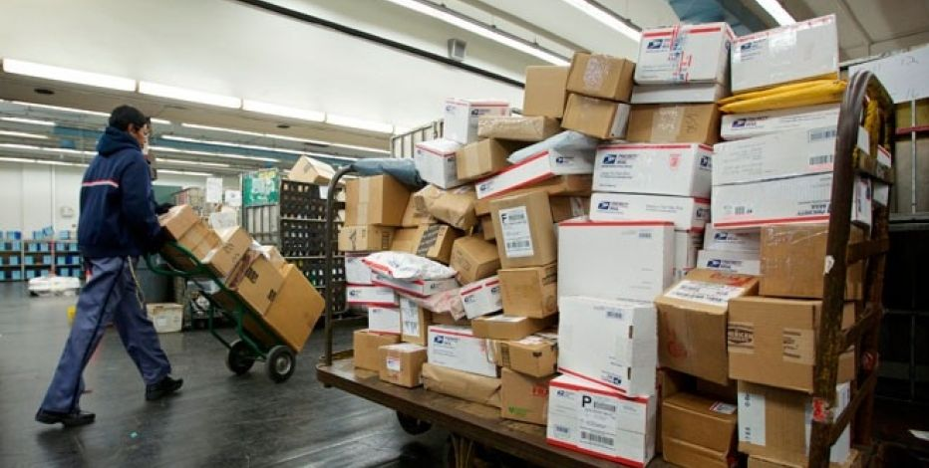

Router
The postman in the Internet
  store and forward
On arrival of an IP packet, it makes a routing decision based on the packet’s destination IP address.
Routing decision: to choose the next router to forward the packet, based on a routing table
Network
Packets
Out of Scope

Slide 18
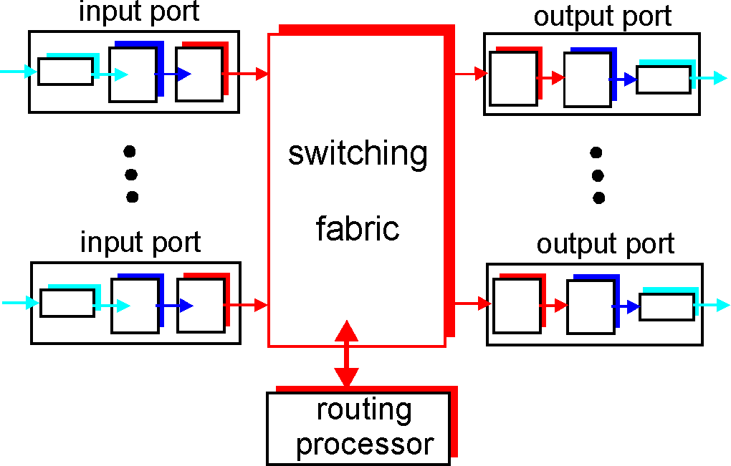
Router Architecture Overview
Two key router functions:
run routing algorithms/protocol
forwarding datagrams from incoming to outgoing link
Out of Scope

Slide 19
Demo
How far away is Johor Bahru from us?
Try traceroute www.utm.my
Windows 10 command: tracert
MAC command: traceroute
Out of Scope
Notes:
Traceroute is a utility that records the Internet route (gateway computers at each hop) between your computer and a specified destination computer. It also calculates and displays the amount of time for each hop. This utility helps you find where high transfer times are occurring in your internal network and the Internet. Before using Traceroute, you can use the Ping utility to identify whether a host is present on the network.

Slide 20
Defining Security

Slide 21





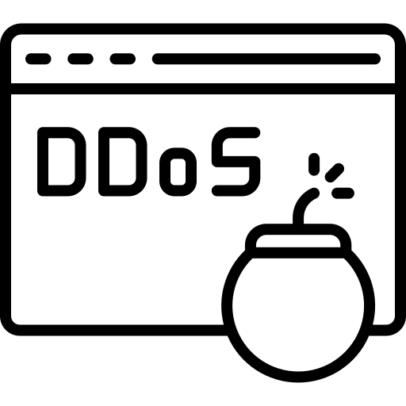
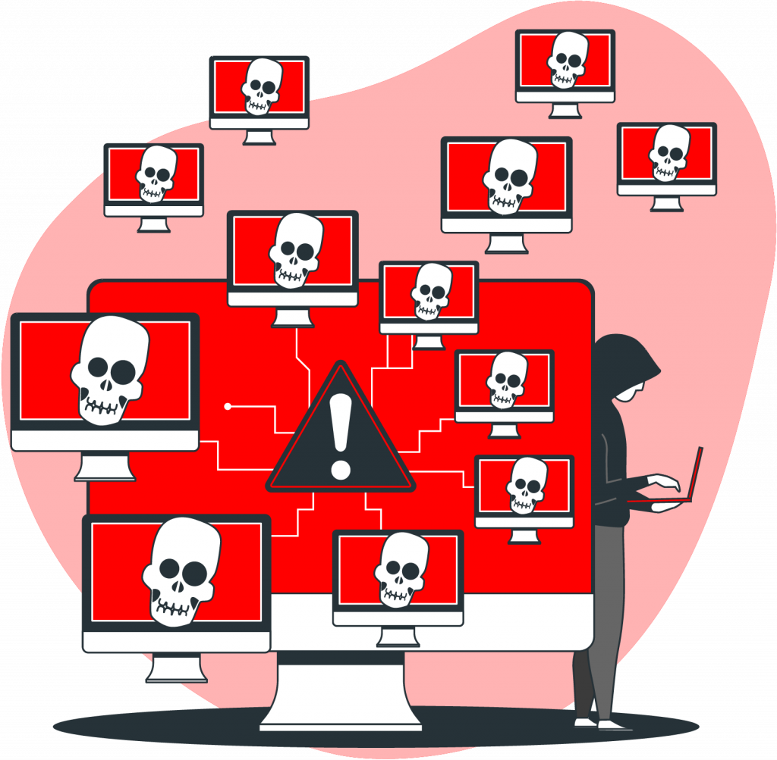

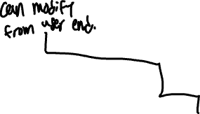
Example - CIA Triad
Electronic Transfer
CONFIDENTIALITY
1. Username & Password Authentication
2. “Transfer $100 to Bob”
AVAILABILITY
“Transfer $1,000 to Alice”
INTEGRITY
What are the potential attacks in the above scenario?

Slide 22

Classical Security Objectives
INTEGRITY
  Information is not modified by unauthorized parties.
AVAILABILITY
Information can be accessed by authorized parties at proper time.
CONFIDENTIALITY
Information is not exposed to unauthorized parties.
The CIA triad (NIST standard FIPS 199)

Slide 23
Some Security Terms
Authentication: the ability of a system to confirm the identity of a sender
Authorization: the ability of a system to provide correct level of access that a user should have based on their credentials
Accounting: the ability of a system to keep track of what users do while they are logged into a system.

Slide 24
Threat, Vulnerability & Attack
Threat
  something bad that could happen
Vulnerability
  weakness in an information system that could be exploited
Incident
  when a vulnerability is exploited to compromise the security of systems, the result is a security incident
Attack
  some action taken by a malicious intruder
  Passive Adversary
  Active Adversary

Slide 25
Sources of Cybersecurity Threats
(United States Government Accountability Office GAO-10-606)
Bot-network operators | Use a network, or bot-net, of compromised, remotely controlled systems to coordinate attacks and to distribute phishing schemes, spam, and malware attacks. The services of these networks are sometimes made available on underground markets.
Criminal groups | Seek to attack systems for monetary gain (e.g., identity theft and online fraud) or conduct industrial espionage. They hire or develop hacker talent.
Hackers | Break into networks for the thrill of the challenge, bragging rights in the hacker community, revenge, stalking others, and monetary gain, among other reasons
Insiders | Includes disgruntled employees, contractors hired by the organization, as well as employees who accidentally introduce malware into systems.
Nations | Nations use cyber tools as part of their information-gathering and espionage activities. In addition, several nations are aggressively working to develop information warfare doctrine, programs, and capabilities.
Phishers | Individuals, or small groups, execute phishing schemes in an attempt to steal identities or information for monetary gain
Spammers | Individuals or organizations distribute unsolicited e-mail with hidden or false information in order to sell products, conduct phishing schemes, distribute spyware/malware, or attack organizations (i.e., denial of service).
Spyware/malware authors | Individuals or organizations with malicious intent carry out attacks against users by producing and distributing spyware and malware.
Terrorists | Seek to destroy, incapacitate, or exploit critical infrastructures in order to threaten national security, cause mass casualties, weaken a nation’s economy, and damage public morale and confidence.

Slide 26
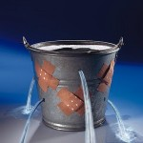
Asymmetry: Defense is So Hard
  An intruder only needs to find one vulnerability
  Defender needs to control all possible vulnerabilities
Principle of Easiest Penetration
An intruder can exploit any vulnerability to launch a penetration or attack

Slide 27
How to Achieve Security (Control)
Policy
  What we are trying to protect
Mechanism
  How to enforce the security policy
Assurance
  How well the security mechanism enforces the policy
Security
Assurance
Mechanism
Policy

Slide 28


Can We Hide?
Security by Obscurity
  A system would be secure if we hide its insides
  Does this work?
Kerckhoff’s Principle (1883): Only the key should be kept secret, while the algorithm itself should be publicly known.

Slide 29

Security Tradeoffs
Good-enough security is good enough
Security
Performance
Compatibility
Cost
Functionality
Ease of use
Security

Slide 30
Takeaway
Three types of threats
Confidentiality, integrity, availability definitions and other security definitions
Computers & Networking
Trade-off of implementing security

